Slide 1

Reduced Order Models (ROMs) RAVEN Workshop

Slide 2
Outline
Brief introduction on ROMs
ROMs and RAVEN
Available ROMs
RAVEN ROM workflow
RAVEN examples
Create ROMs
Perform sampling of ROMs

Slide 3
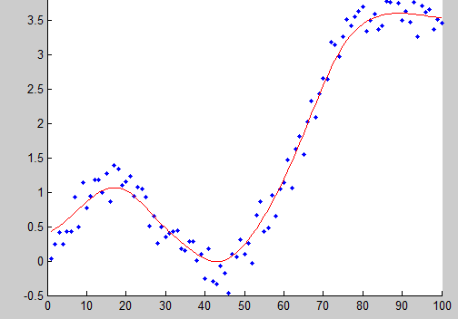
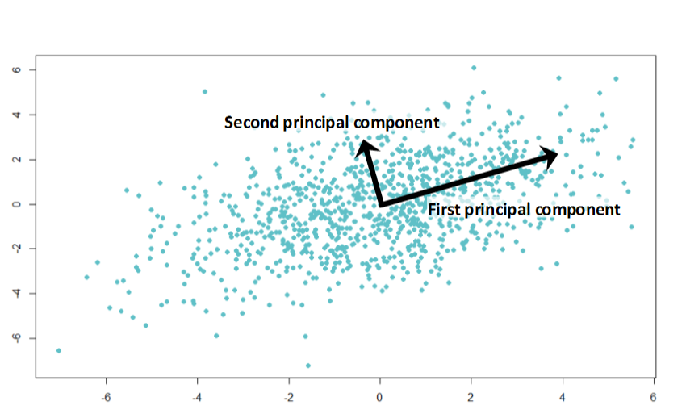
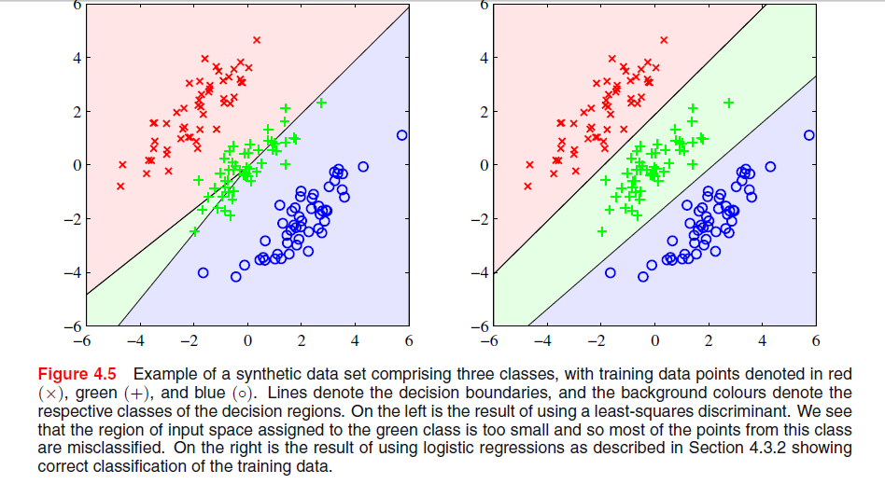
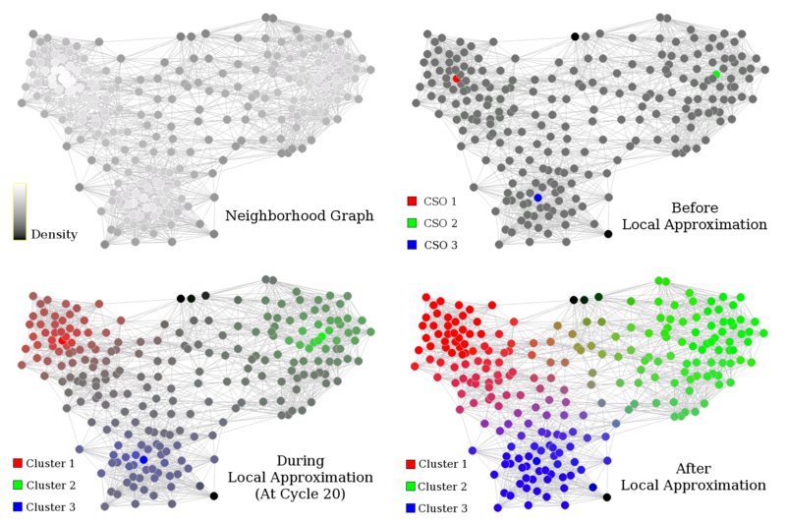
Methods and Taxonomy
LA
Opt
Alg
Stat
'Field of study that gives
computers the ability to learn
without being explicitly
programmed’ – Arthur Samuel 1959
ML
Supervised
Unsupervised
Reinforcement
ROM
Regression
Dimensionality Reduction
Q-learning
Classification
Clustering
SARSA
DeepRL

Slide 4
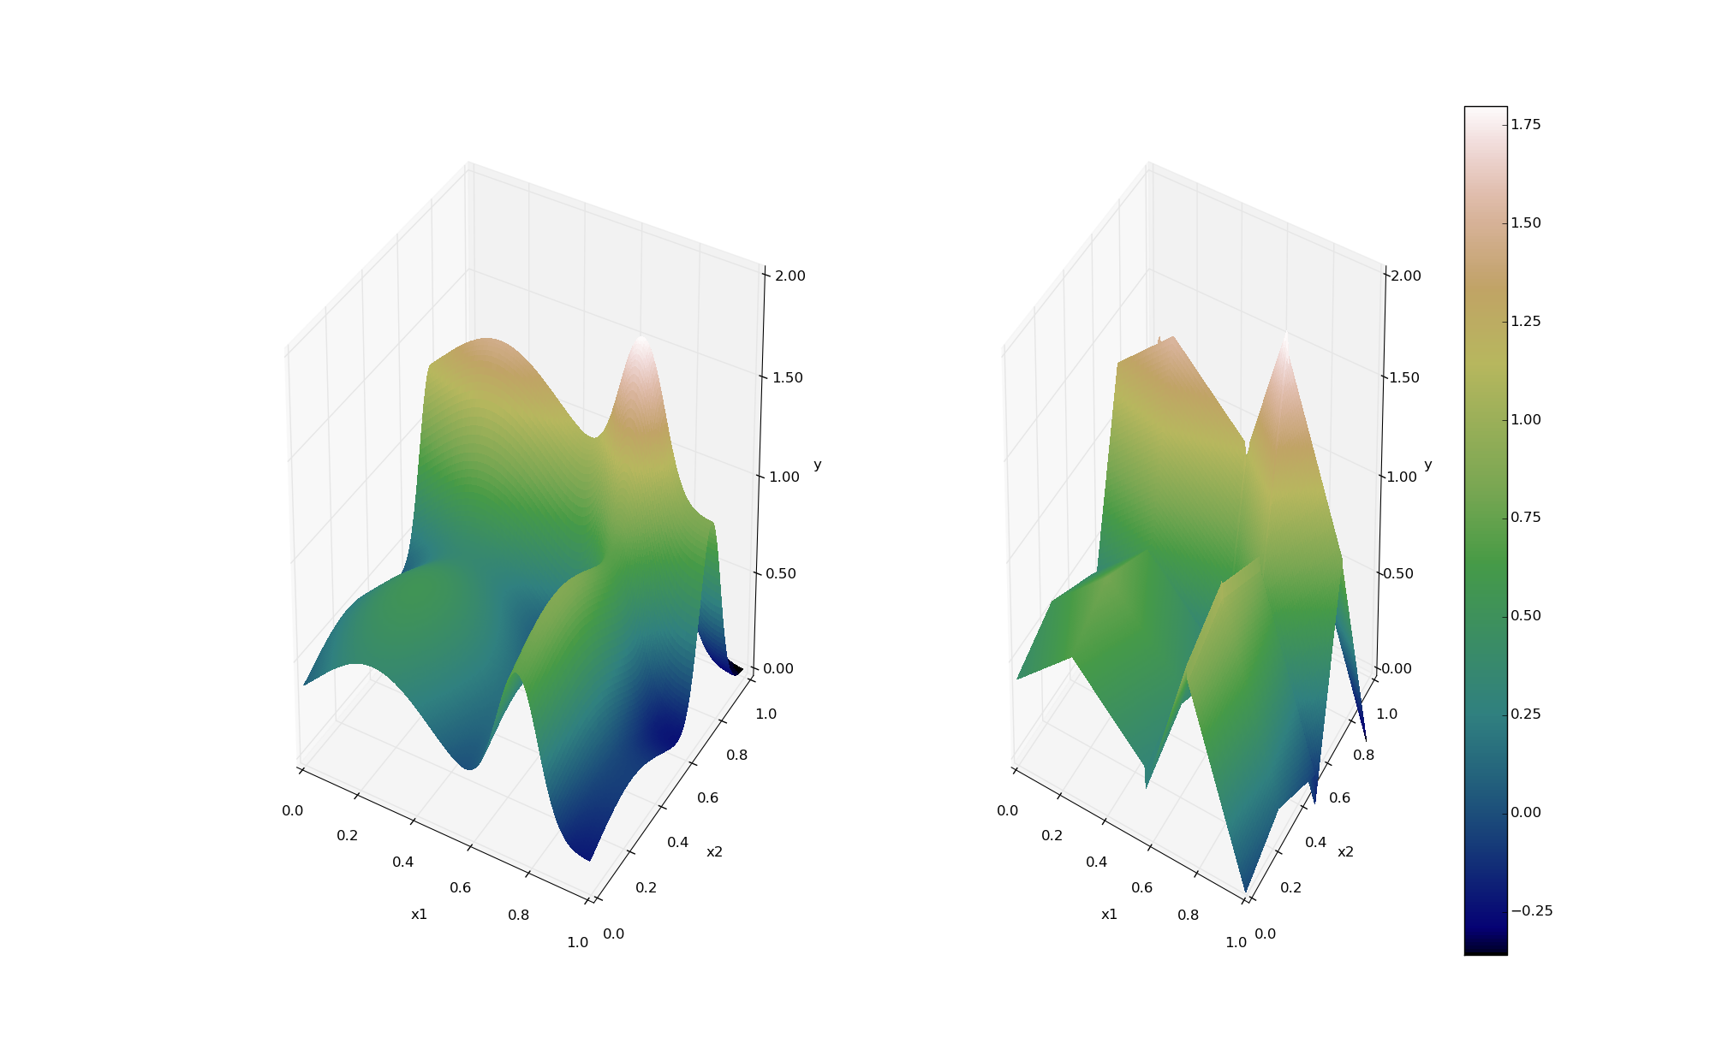
ROMs: a Brief Introduction
Output: Simulation outcome (success/failure, max clad temperature)
Consider a set of N data points
Build a surrogate model
Reduced Order Model
DataObjects
(PointSet)
Inputs: Initial and boundary conditions
≅

Slide 5
ROMs: a Brief Introduction
Basically we are trying to reduce the complexity of the original model
Pros:
Much faster computation of the output variable
Cons:
Presence of error in the ROM computed values
ROM (e.g., quadratic regressor)
≅
Original data (e.g., RELAP5)

Slide 6
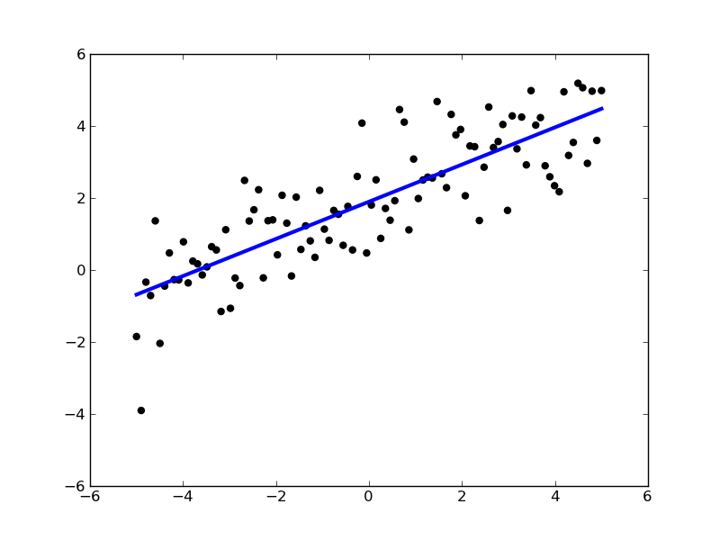
ROMs: Applications
Basic steps:
Sample original model
Train the ROM
Validate the ROM
Perform desired analysis with the ROM
instead of the original model
Range of applications:
Uncertainty quantification / Sensitivity analysis
Probabilistic Risk Analysis (PRA)
Accelerator for stochastic analysis (adaptive sampling)
Prediction models
Output y
Input x

Slide 7
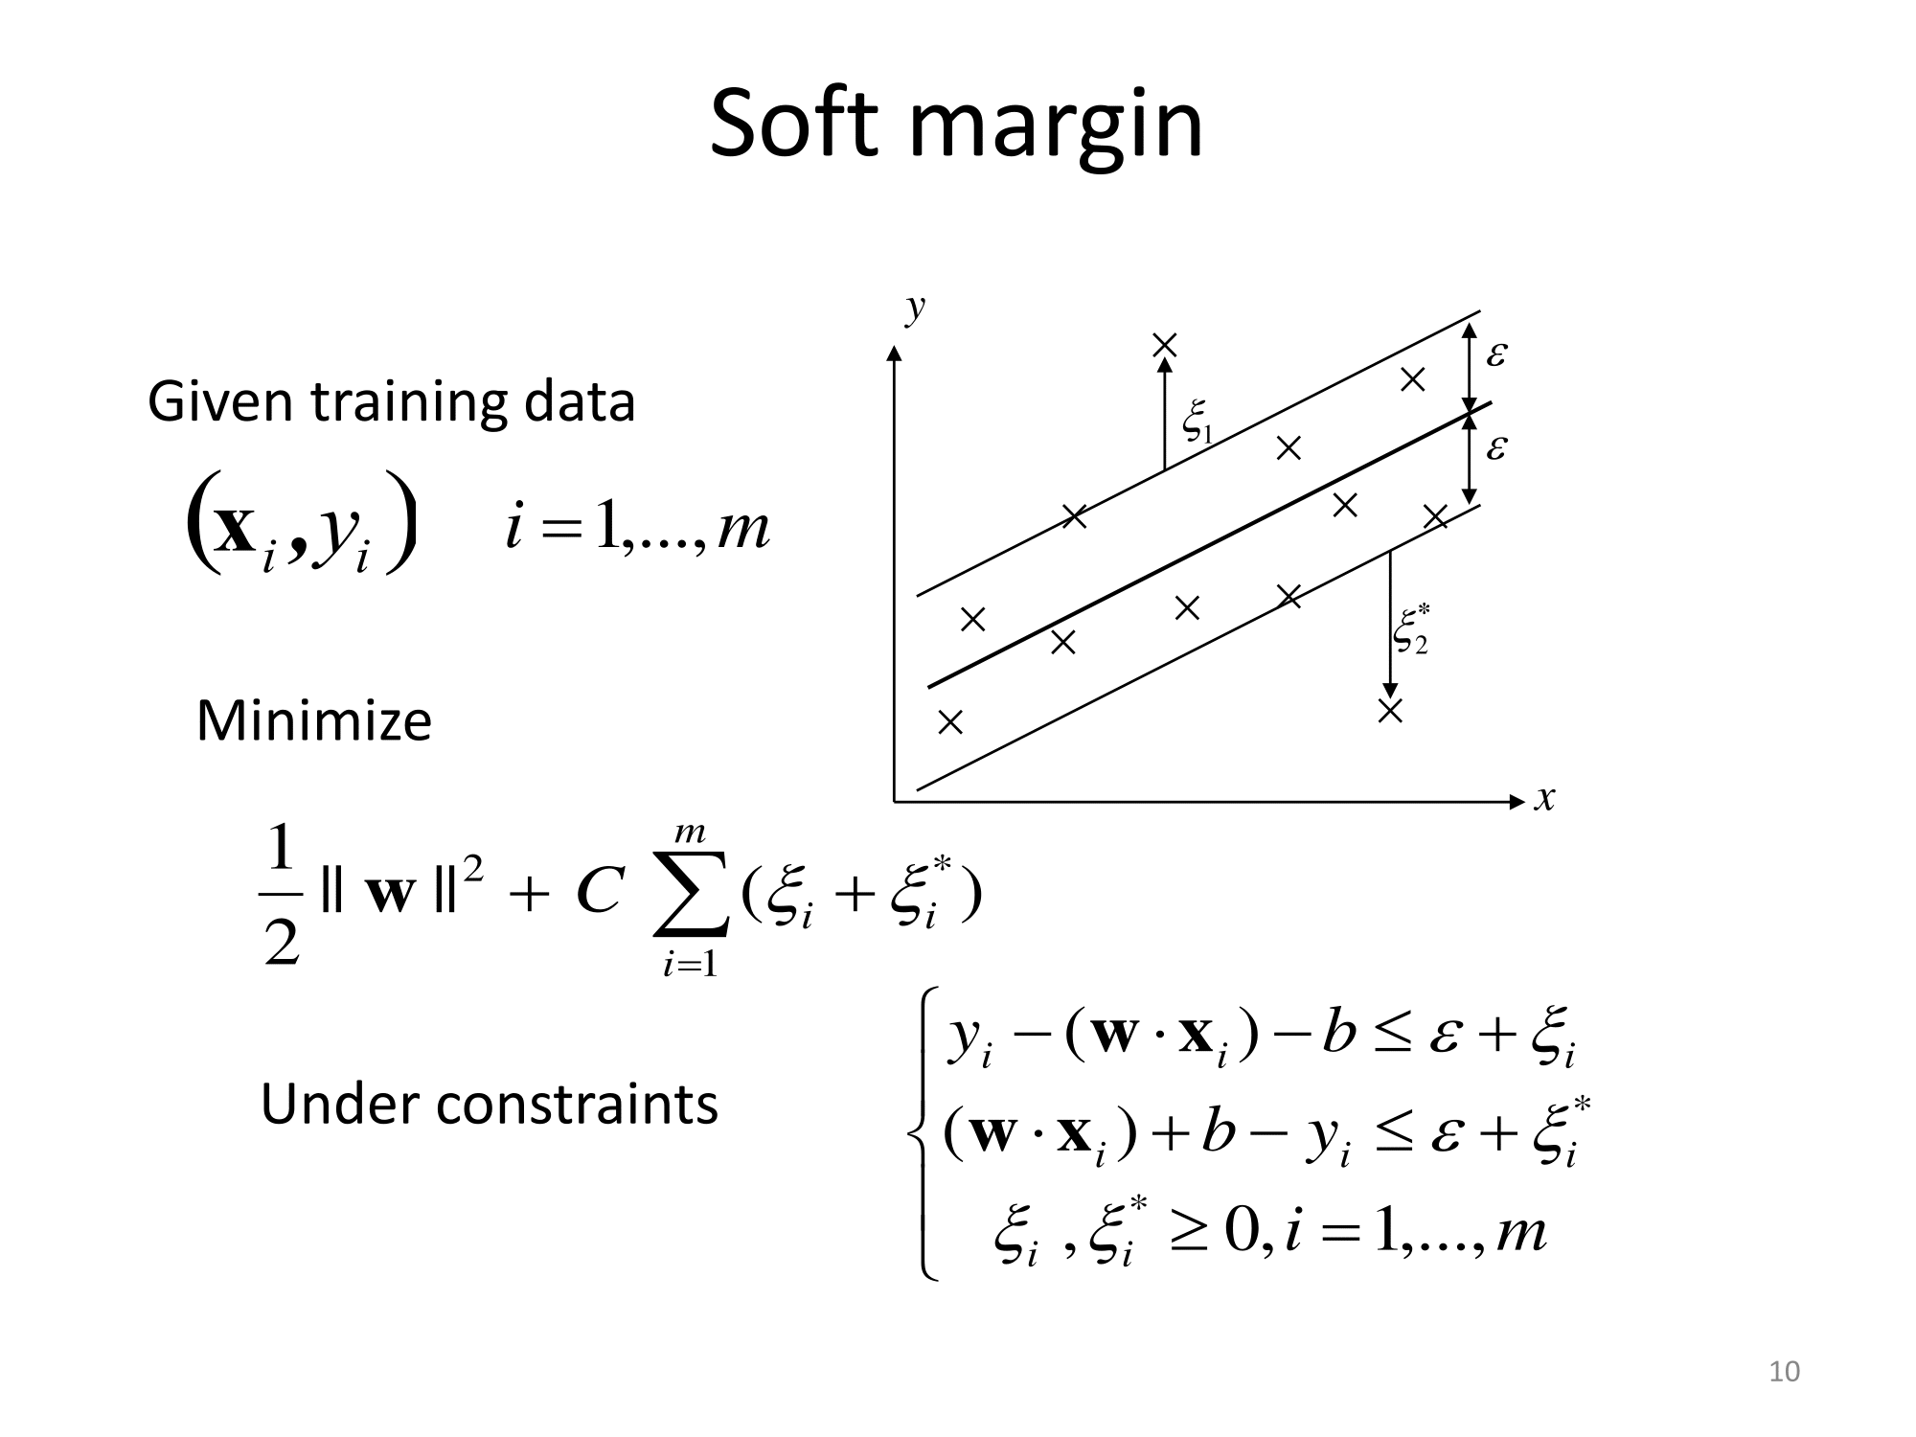
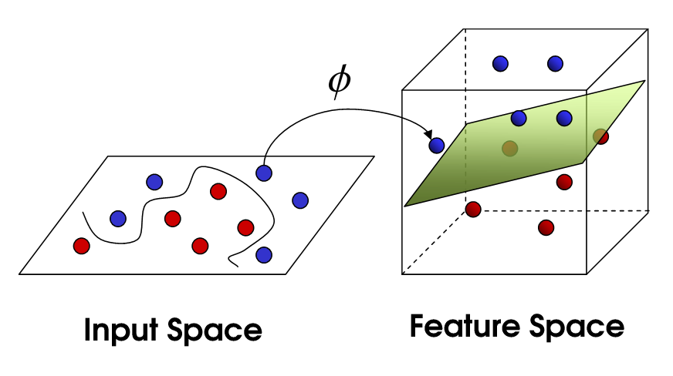
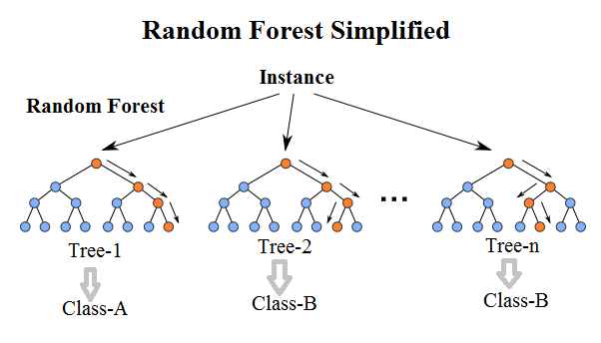
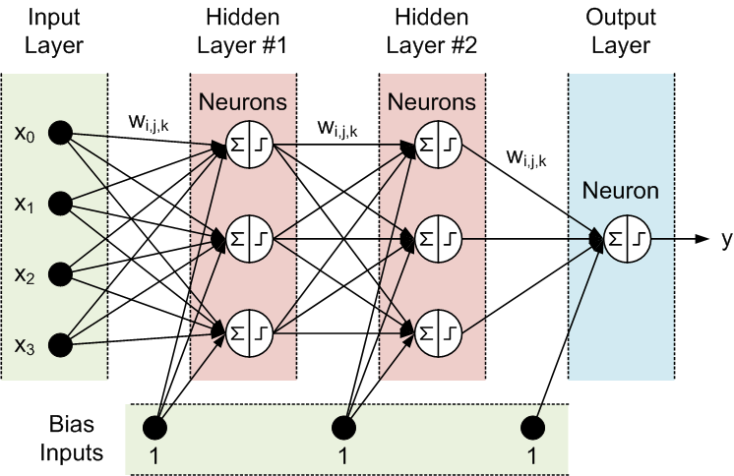

Potential Surrogate models (i.e., ROMs)
Support Vector Machines
Neural Networks
7

Slide 8
ROM Modeling Within RAVEN
All modeling steps that involve ROMs are available in RAVEN
Create ROMs from a database
Perform statistical analysis using ROMs

Slide 9
ROM Modeling Within RAVEN
Create a Database (PointSet)

Slide 10
ROM Modeling Within RAVEN
Create and train a ROM from a Database

Slide 11
ROM Modeling Within RAVEN
Perform statistical analysis using the ROM

Slide 12
ROM Pickle
Compression/serialization scheme
Pickled object contains all the information necessary to reconstruct the object in another python script
Pickled object can be saved as a file
RAVEN Scikit-Learn ROMs can be pickled
Applications:
Perform statistical analysis on a ROM after they have been generated and/or on a different machine
Use pickled ROMs on separate python script (external model for RAVEN)
Stochastic analysis for different distributions

Slide 13
ROMs Available in RAVEN
NDspline/NDinvDistWeight: Multi-dimensional interpolators
GaussPolynomialRom/HDMRRom: Stochastic collocation
SciKitLearn (External library)
Linear Models
Support Vector Machines
Multi Class
Naïve Bayes
Neighbors
Tree
Gaussian process
Neural Network Models
ARMA: Autoregressive moving average time series model
MSR: Perform topological decomposition
PolyExponential: polynomial sum of exponentials for time-dependent
DMD: dynamic mode decomposition for time-dependent ROM

Slide 14
RAVEN ROM Hands-on Session

Slide 15
Getting on the same page
This workshop will include interactive examples
paths given starting at raven
Slides are provided as well:
~> cd ~/projects/raven
~/projects/raven> git checkout devel
~/projects/raven> git pull
raven/doc/workshop/reducedOrderModeling

Slide 16
Example Code
RAVEN samples codes
For experiment, we’ve provided some physics in a code
projectile.py
Given:
y0, the initial vertical position
x0, the initial horizontal position
angle, the launch angle
v0, the launch velocity
Calculates:
x, the horizontal position throughout the trajectory
y, the vertical position throughout the trajectory
r, the horizontal range or furthest point reached if landed on the same horizontal level.
t, the time of flight.
ymax, the maximum height achieved.

Slide 17
Workflow/Pipeline
2_train_rom.xml
4_load_rom.xml
Train a ROM
(Validate Visually)
Pickle ROM
Load ROM
Sample model Create data cloud
Train and Validate
3_pickle_rom.xml
Load From a pretrained pickle
1_sample_Function.xml
2b_train_and_validate_rom.xml
4b_load_and_sample_pretrained_rom.xml
5_Complete_rom_example.xml
Complete ROM Workflow

Slide 18
Workflow/Pipeline:
2_train_rom.xml
4_load_rom.xml
Train a ROM
(Validate Visually)
Pickle ROM
Load ROM
Sample model Create data cloud
Train and Validate
3_pickle_rom.xml
Load From a pretrained pickle
1_sample_Function.xml
2b_train_and_validate_rom.xml
4b_load_and_sample_pretrained_rom.xml
5_Complete_rom_example.xml
Complete ROM Workflow

Slide 19
Sample a Model and Create a Database (Exercise 1)
Distributions
Models
Samplers
Databases
DataObjects
Steps
<Steps>
<MultiRun name="FirstMRun">
<Input class="DataObjects" type="PointSet" >inputPlaceHolder</Input>
<Model class="Models" type="ExternalModel”>projectile</Model>
<Sampler class="Samplers" type="Grid" >grid</Sampler>
<Output class="DataObjects" type="PointSet" >outGRID</Output>
<Output class="Databases" type="HDF5" >out_db</Output>
<Output class="OutStreams" type="Print" >out_dump</Output>
</MultiRun>
</Steps>
Model file
Step
Database
Model info
Sampler
DataObjects
Starter input file name: 1_sample_Function.xml (Just run it!)

Slide 20
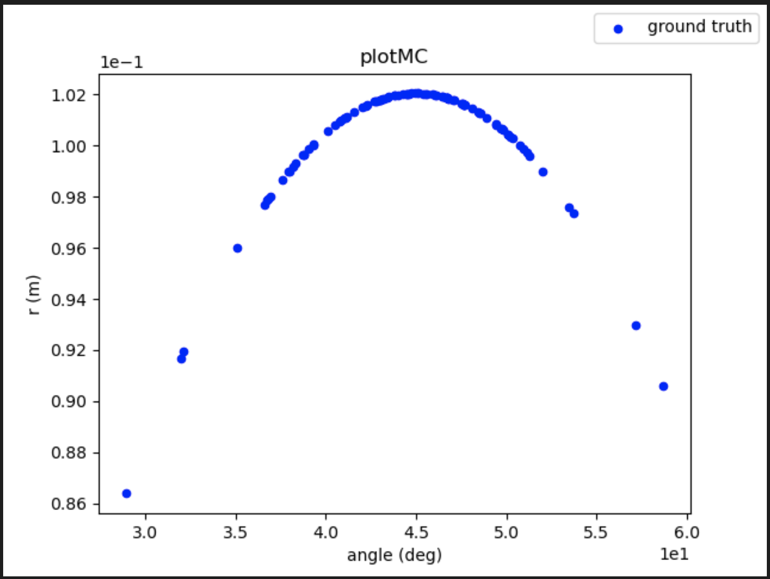
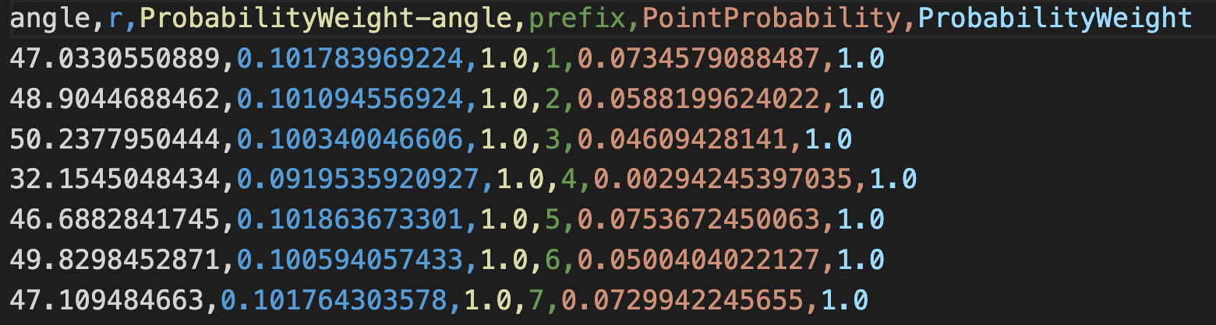
Exercises 1
Exercise 1_sample_Function.xml, objective: prepare the training data via forward sampling.
Just run this one.
Outputs:

Slide 21
Workflow/Pipeline
2_train_rom.xml
4_load_rom.xml
Train a ROM
(Validate Visually)
Pickle ROM
Load ROM
Sample model Create database
Train and Validate
3_pickle_rom.xml
Load From a pretrained pickle
1_sample_Function.xml
2b_train_and_validate_rom.xml
4b_load_and_sample_pretrained_rom.xml
5_Complete_rom_example.xml
Complete ROM Workflow

Slide 22
Train a ROM
Distributions
Models
Samplers
Databases
DataObjects
Steps
<Steps>
...
<RomTrainer name="rom_trainer4">
<Input class="DataObjects" type="PointSet" >outGRID_y4</Input>
<Output class="Models" type="ROM" >ROM4</Output>
</RomTrainer>
...
</Steps>
Starter Input file name: 2_train_ROM.xml

Slide 23
Train a ROM
Distributions
Models
Samplers
Databases
DataObjects
Steps
<Models>
<ROM name="ROM4" subType="NDinvDistWeight">
<Features>v0,angle</Features>
<Target>t,x,y,r</Target>
<p>3</p>
</ROM>
</Models>
Multi-dimensional interpolator (CROW)
Starter Input file name: 2_train_ROM.xml

Slide 24
Exercises 2
Exercise 2_train_rom.xml, objective: train/construct the rom.
Add a step to train the rom to your <Steps> and <Sequence>.
Complete the <ROM> block in <Models> (for now stick to using the NDinvDistWeight rom.
Complete the DataObjects block.
Complete the <Plot> in <OutStreams>
Run
Outputs:
No new outputs, because we have trained a ROM but did not save it (pickle it), validate it, sample it, plot its output, etc.
~/.../reducedOrderModeling/exercises> raven_framework 2_train_rom.xml

Slide 25
Workflow/Pipeline
2_train_rom.xml
4_load_rom.xml
Train a ROM
(Validate Visually)
Pickle ROM
Load ROM
Sample model Create database
Train and Validate
3_pickle_rom.xml
Load From a pretrained pickle
1_sample_Function.xml
2b_train_and_validate_rom.xml
4b_load_and_sample_pretrained_rom.xml
5_Complete_rom_example.xml
Complete ROM Workflow

Slide 26
Exercises 2b
Exercise 2b_train_and_validate_rom.xml, objective: Split the data and train/construct the ROM, then cross-validate by computing scores/error metrics.
Add the new Postprocess step name to the <Sequence> (It was already added to the <Steps>).
Complete the <ROM> block in <Models>
Complete the <PostProcessor> in models by completing the <Metric> nodes
Complete the <outPP> PointSet by adding the outputs on the form: cv_{metricName}_{targetName}
Run
~/.../reducedOrderModeling/exercises> raven_framework 2b_train_and _validate_rom.xml

Slide 27
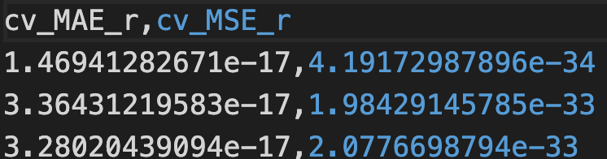
Exercises 2b
Additional outputs:
Why are there only 3 rows?

Slide 28
Workflow/Pipeline
2_train_rom.xml
4_load_rom.xml
Train a ROM
(Validate Visually)
Pickle ROM
Load ROM
Sample model Create database
Train and Validate
3_pickle_rom.xml
Load From a pretrained pickle
1_sample_Function.xml
2b_train_and_validate_rom.xml
4b_load_and_sample_pretrained_rom.xml
5_Complete_rom_example.xml
Complete ROM Workflow

Slide 29
Pickle a ROM
Models
Databases
DataObjects
Steps
<Steps>
...
<IOStep name="pkDump">
<Input class="Models" type="ROM" >ROM3</Input>
<Output class="Files" type="" >ROM3pk</Output>
</IOStep>
</Steps>
Pickle the ROM and save it as a file
Starter input file name: 3_pickle_rom.xml

Slide 30
Exercises 3
Exercise 3_pickle_rom.xml, objective: Save the trained ROM in a serialized/binary format (pickle) for future and/or instantaneous use.
Fill the <workingDir>
Add the new step to the <Sequence> node
Fill in the Final step in <Steps>
Fill the Files block
Run
~/.../reducedOrderModeling/execises> raven_framework 3_pickle_rom.xml

Slide 31

Exercises 3
Additional outputs:
Pickle file: ~/projects/raven/doc/workshop/reducedOrderModeling/exercises/r3/IDW.pk

Slide 32
Workflow/Pipeline
2_train_rom.xml
4_load_rom.xml
Train a ROM
(Validate Visually)
Pickle ROM
Load ROM
Sample model Create database
Train and Validate
3_pickle_rom.xml
Load From a pretrained pickle
1_sample_Function.xml
2b_train_and_validate_rom.xml
4b_load_and_sample_pretrained_rom.xml
5_sample_rom.xml
Sample/evaluate ROM
Sample/evaluate pROM
6_sample_prom.xml

Slide 33
Load a Pickled ROM
Distributions
Models
Samplers
DataObjects
Steps
Load the pickled ROM
<Steps>
...
<IOStep name="pk3Load">
<Input class="Files" type="" >ROM3pk</Input>
<Output class="Models" type="ROM" >pROM3</Output>
</IOStep>
...
</Steps>
Starter input file name: 4_load_pickled_rom.xml

Slide 34
Exercises 4
Exercise 4_load_rom.xml, objective: Load the model stored in the pickle to use it later.
Add the new IO step that loads a model from the pickle file to the <Sequence> node.
Complete the same IO step in the <Steps> block.
Run:
Additional outputs: Note that no additional outputs since we loaded the ROM but did not use it here.
~/.../reducedOrderModeling/execises> raven_framework 4_load_rom.xml

Slide 35
Exercises 4
Note that There were two similar <ROM> subblocks in the <Models> block in this exercise one to train and another to load. This is not mandatory, and one could have been used for both purposes.
More importantly:
What if the pickle was generated a long time ago and we do not remember the ROM details?? How can we write this loading <block> when we do not know which ROM or what were the features/targets, what was p?
This is what motivates exercise 4b

Slide 36
Workflow/Pipeline
2_train_rom.xml
4_load_rom.xml
Train a ROM
(Validate Visually)
Pickle ROM
Load ROM
Sample model Create database
Train and Validate
3_pickle_rom.xml
Load From a pretrained pickle
1_sample_Function.xml
2b_train_and_validate_rom.xml
4b_load_and_sample_pretrained_rom.xml
5_Complete_rom_example.xml
Complete ROM Workflow

Slide 37
Load a pretrained Pickled ROM
Distributions
Models
Samplers
DataObjects
Steps
<Models>
...
<ROM name="pROM" subType="pickledROM"/>
</Models>
Starter input file name: 4b_load_and_sample_pretrained_rom.xml

Slide 38
Exercises 4b
Exercise 4b_load_and_sample_pretrained_rom.xml, objective: Load the model stored in the pickle without any knowledge about how it was constructed (black-box pickle).
This starts from the pickle, so all steps to sample the projectile, train the ROM, etc. are removed.
Fill in the <Sequence> node according to the steps in the starter xml
Fill in the IO Step that loads the pickle
In the <Models> block, use a subtype that doesn’t need to provide any information about the ROM construction stage: subtype = “pickledROM”
Do not forget to give the path and name of the pickle in the <Files> block. Use the folder where the pickle was first generated (r3).
Run
~/.../reducedOrderModeling/execises> raven_framework 4b_load_and_sample_pretrained_rom.xml

Slide 39
Workflow/Pipeline
2_train_rom.xml
4_load_rom.xml
Train a ROM
(Validate Visually)
Pickle ROM
Load ROM
Sample model Create database
Train and Validate
3_pickle_rom.xml
Load From a pretrained pickle
1_sample_Function.xml
2b_train_and_validate_rom.xml
4b_load_and_sample_pretrained_rom.xml
5_Complete_rom_example.xml
Complete ROM Workflow

Slide 40
Exercises 5
Exercise 5_complete_rom_workflow.xml, objective: Perform the whole pipeline from space exploration, to rom training, to validation, and sampling/evaluation.
Please navigate the file and try to make sense of it.
Run the file as is and explore the outputs.
Replace all the occurrences of “IDW” (except the one in <ROM> under <Models>. i.e., 12 or 13 occurrences out the 14 occurrences in the file) with one of the following at a time [LR, GP, SVR] which are acronyms for linear regression, Gaussian Process Regressor, Support Vector Regressor, Multi-Layer Perceptron, and Keras MLP respectively. i.e., You can use `Cntrl/Command F` then find IDW and replace it with each one of the lists only in the <Steps> and <Outstreams>
Rerun, and explore the results.
Repeat step 3 on (LR) instead of IDW. (Cntrl/Command F, LR, and replace it with GP, and so on.
~/.../reducedOrderModeling/execises> raven_framework 5_complete_rom_workflow.xml

Slide 41
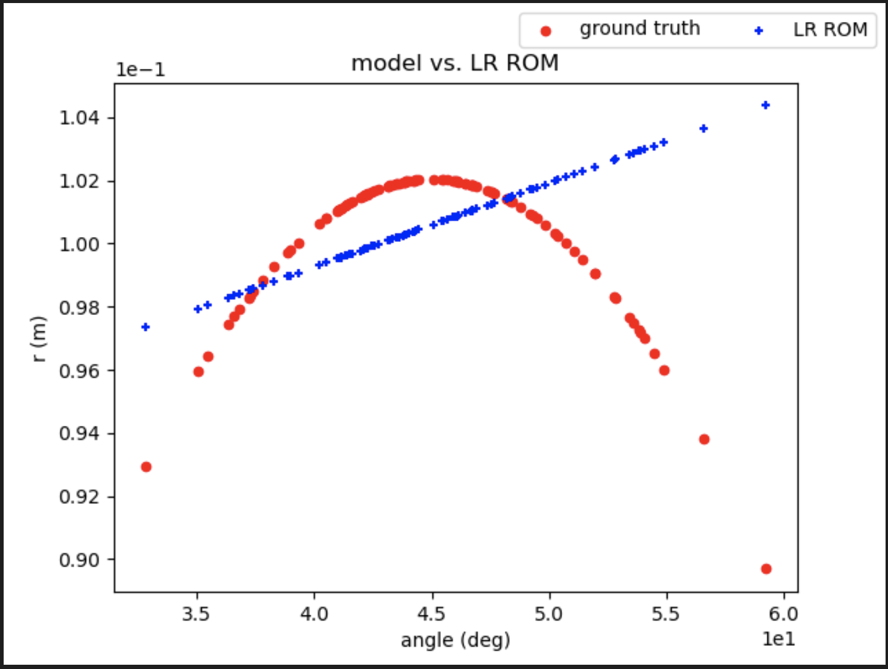
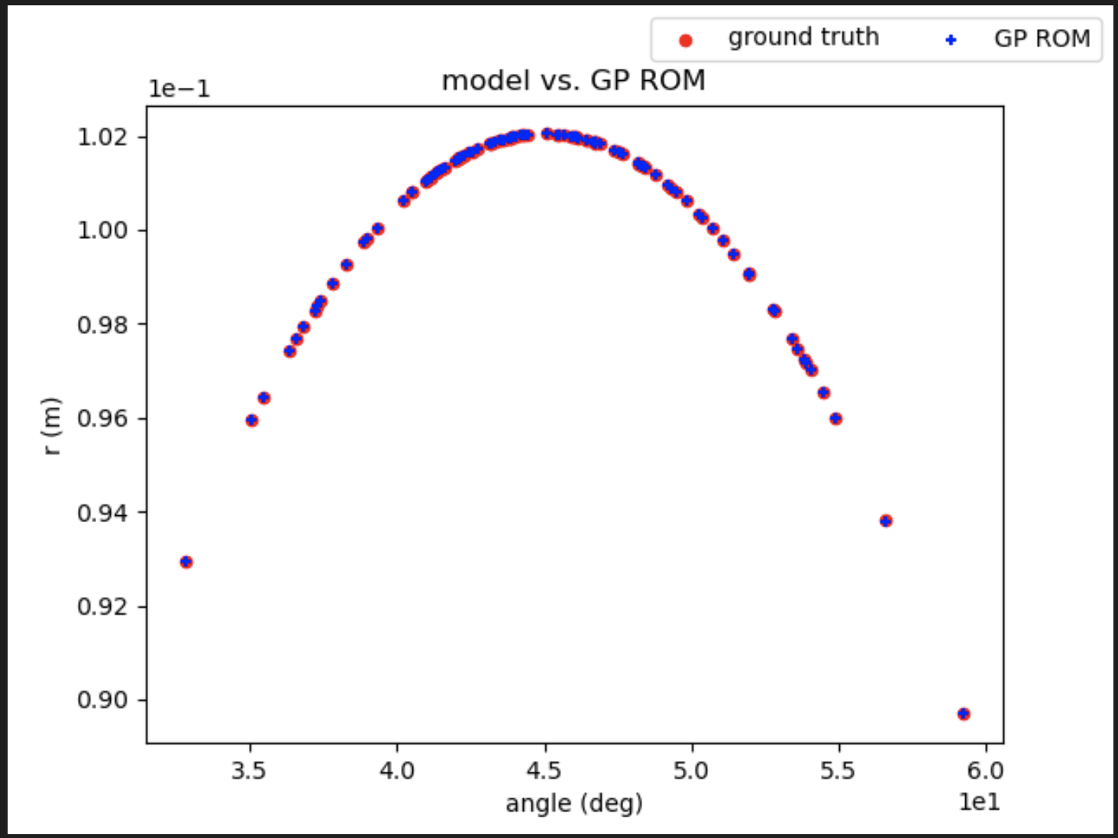
Exercises 5

Slide 42
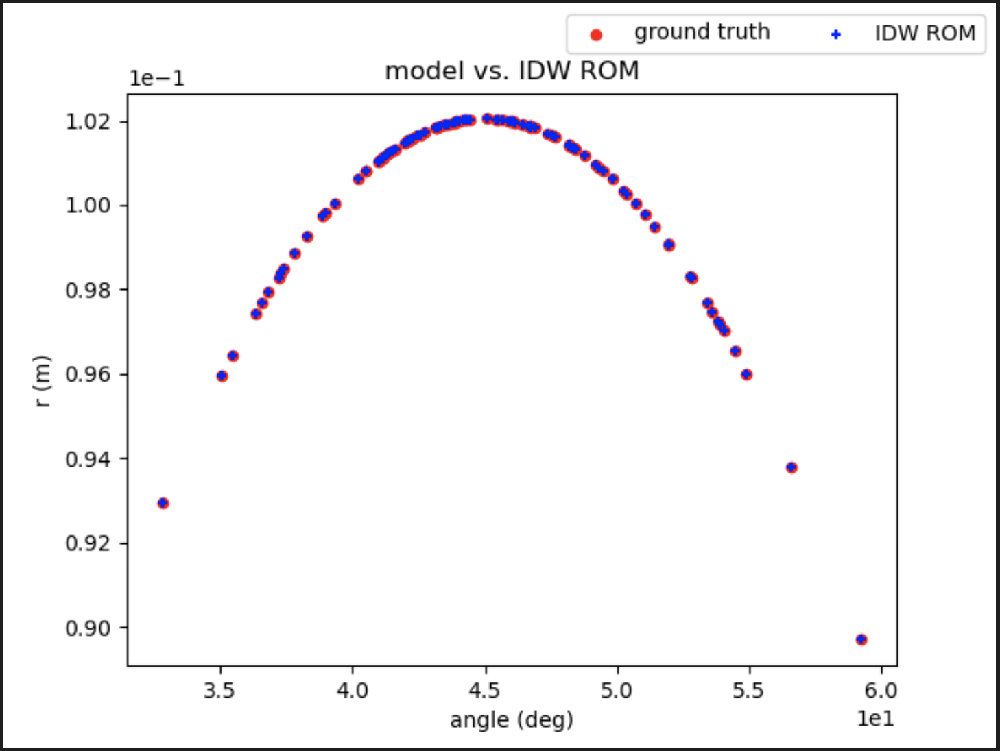
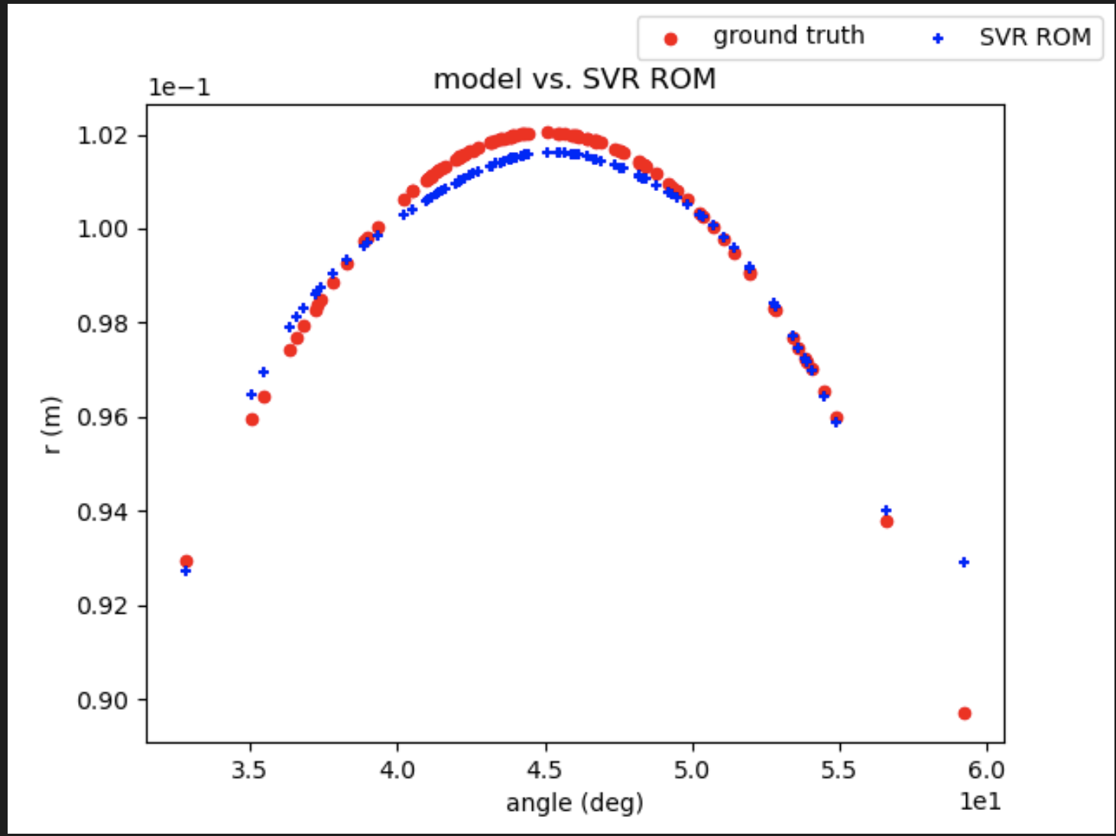
Exercises 5

Slide 43
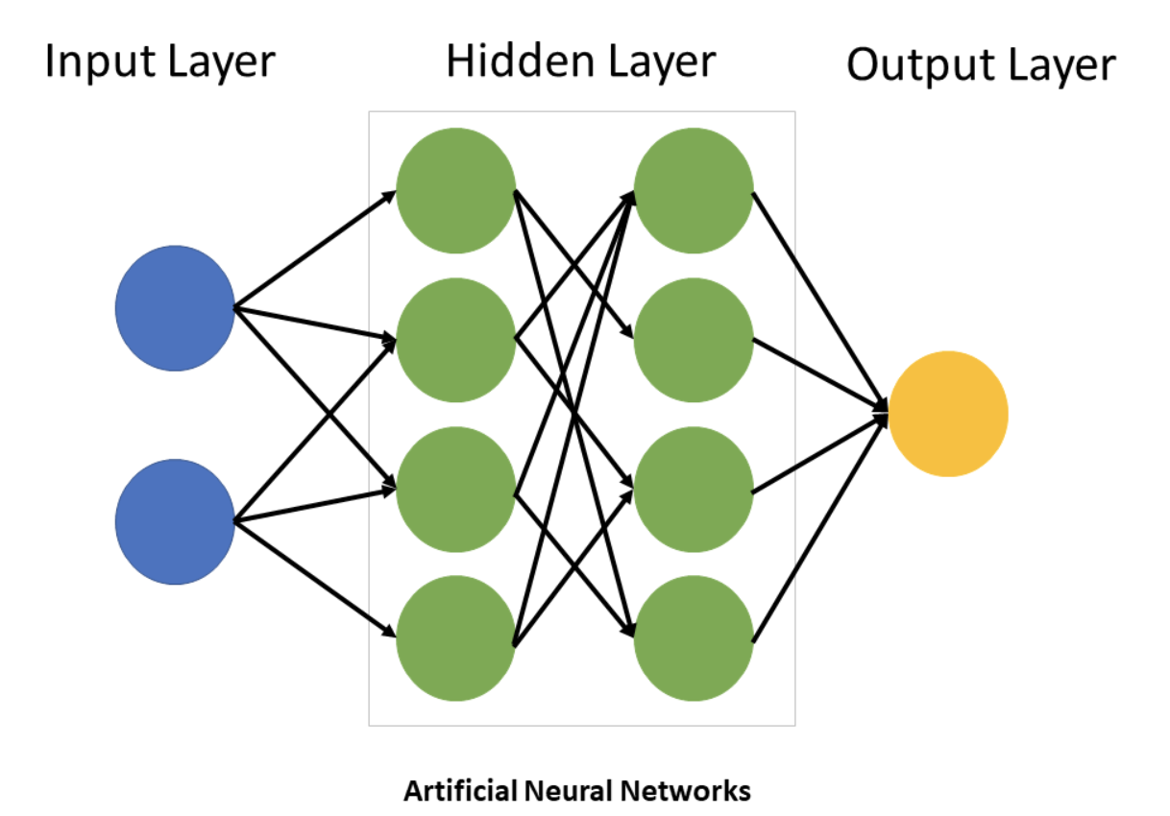
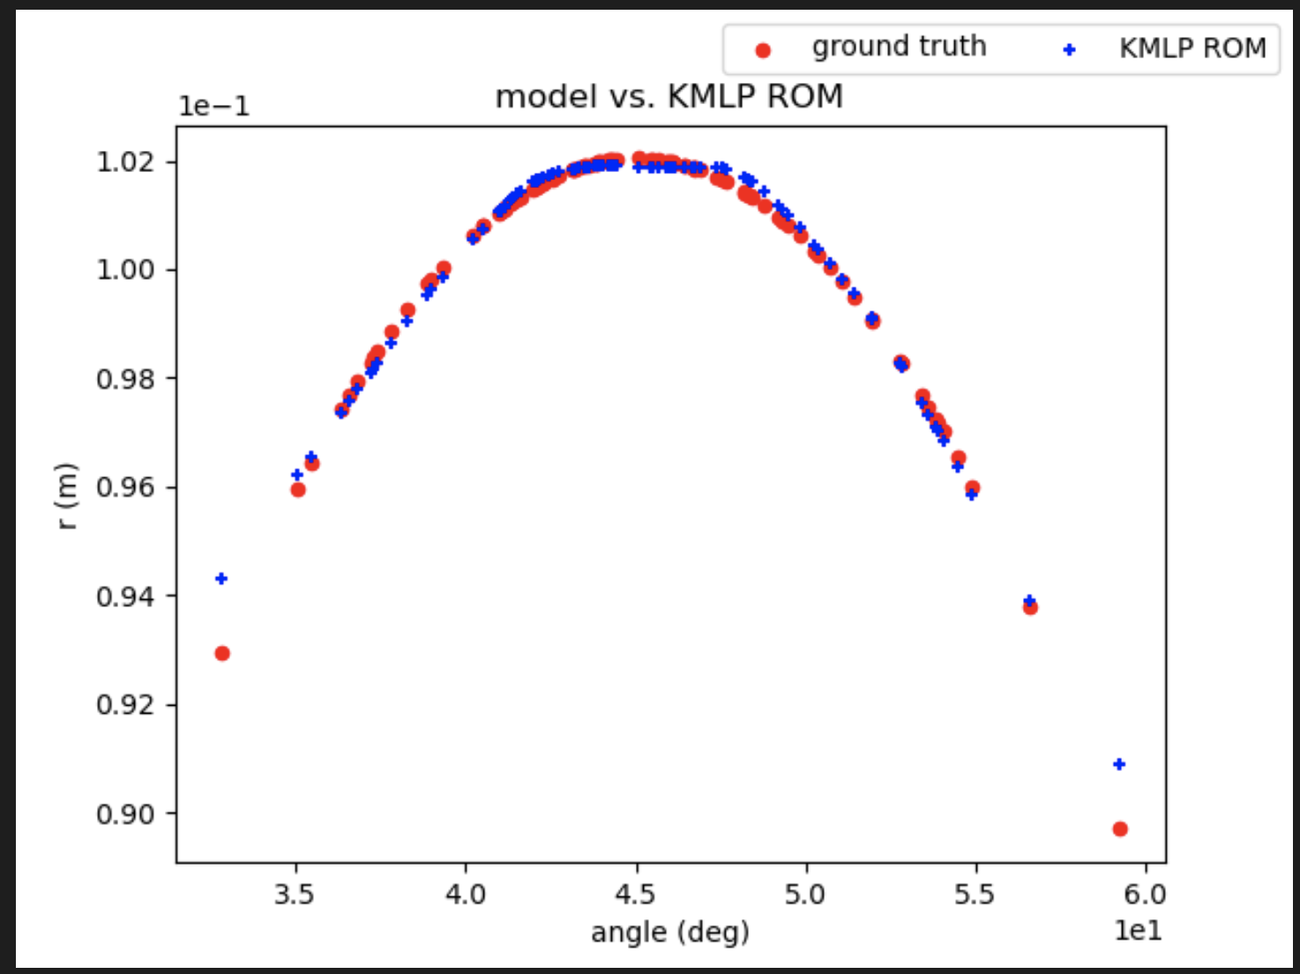
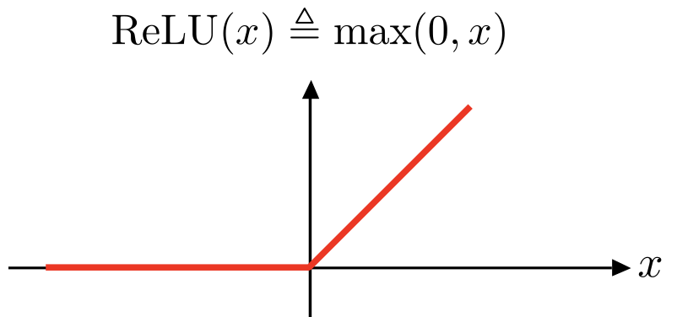
Exercises 5 Keras Multi-Layer Perceptron Regressor
Keras Multi-Layer Perceprton Regressor:
Layer1 Dense, 500, relu
Leyer2 Dense, 300, relu
Layer3 Dense, 200, relu
Layer4 Dense, 100, relu
Output Layer, 1, linear activation

Slide 44
Thank you for your attention

Slide 45








